Slide 1

Resume Parsing
by
Rahul Mehra, Anisha Mohan, Sandhya M Sudi, Karan Satish Kshirsagar, Sanvee Khot, Talha R S Khan, Sharath P
Mentor : BhanuPriya

Slide 2
Business Objectives:
The aim of this project is to build a feature of where a resume is taken as the input and personal, professional, skill set details need to be extracted into a tabular format.
Planning for skilled, semi-skilled & Professional requirement.
To extract the required information about candidates without having to go through each and every resume manually, which ultimately leads to a more time and energy-efficient process.

Slide 3
Business Benefits:
Find the actual requirement for the company.
Search for talent for future openings.
Develop a culture that attracts competent people to the company.
Increased efficiency of the recruitment process. When you collect resumes, using resume parsing software prevents manual data entry.
Human Errors Eliminated.
Quick and Easy Access to Candidate Data.
Optimized Database of Resume Data.
.

Slide 4
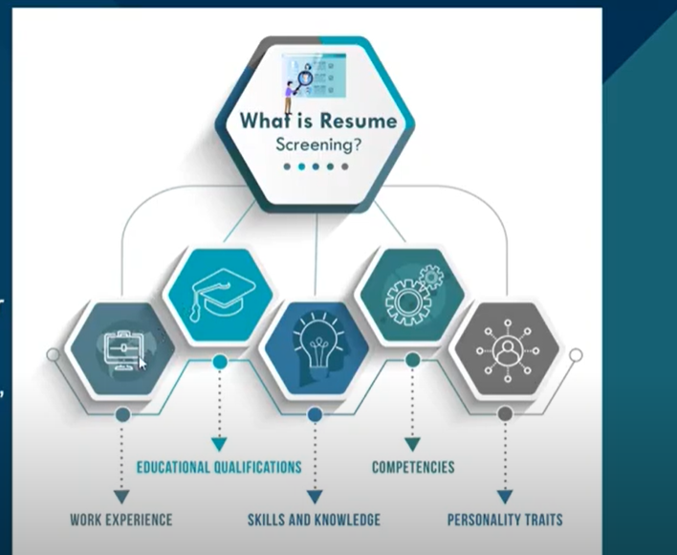
What is resume parsing?
Resume parsing refers to the automated storage, organization and analysis of job resumes. Resume parsing software provides companies an efficient way to identify keywords, skills, and so forth, in order to sort through large quantities of applications to identify the best applicants.

Slide 5
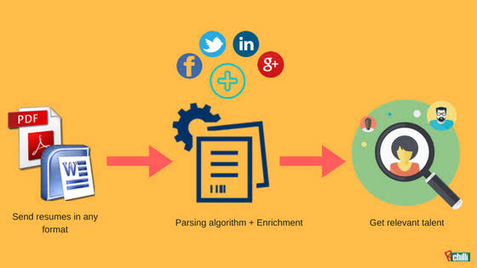
Resume Parsing Process:

Slide 6
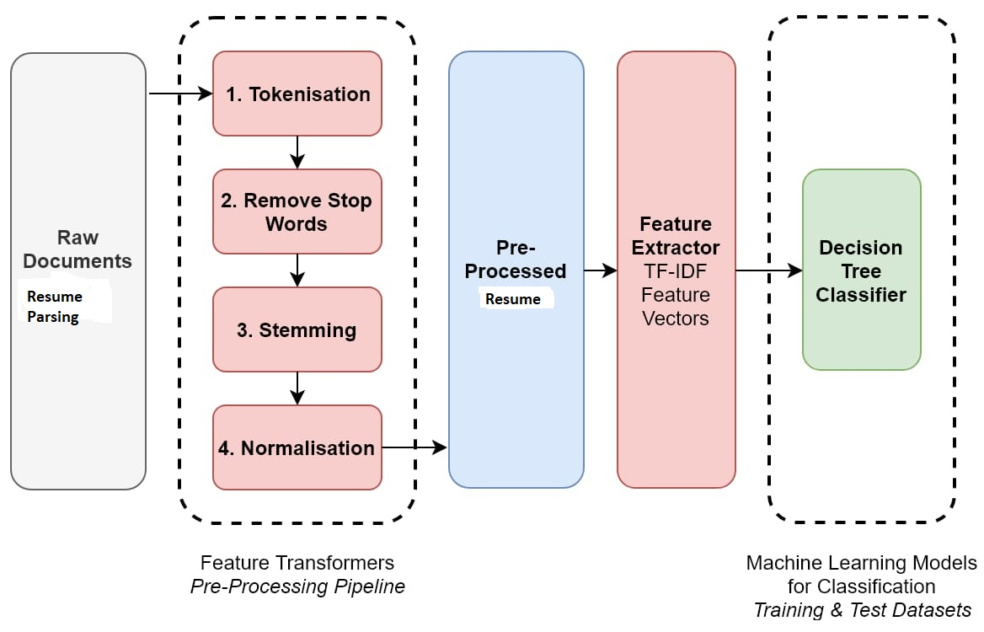
Flow Chart Resume Parsing:

Slide 7
Approaches to create Dataset
Natural Language Processing (NLP)
Python libraries/Python Packages
Predictive Analytics
Regular Expression/Rule Based Parsing
Named Entity Recognition (NER)
Spacy’s NER
BERT NER

Slide 8
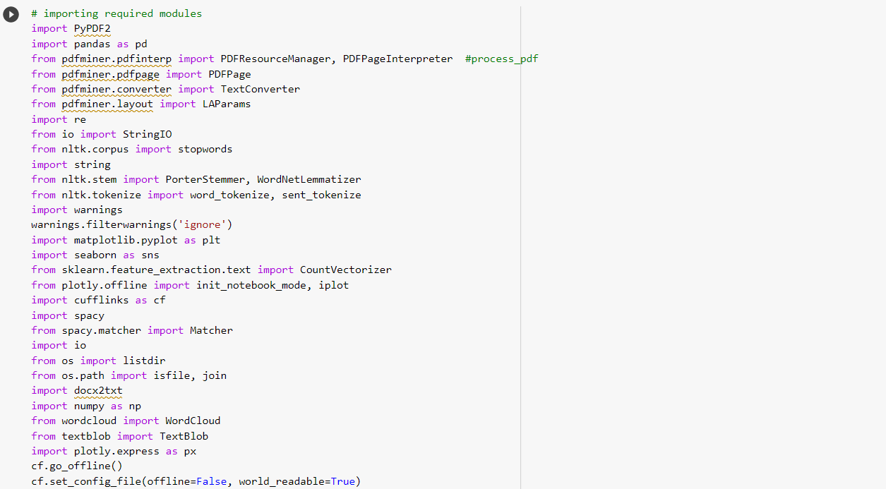
Dataset Libraries Details
Dataset Details

Slide 9
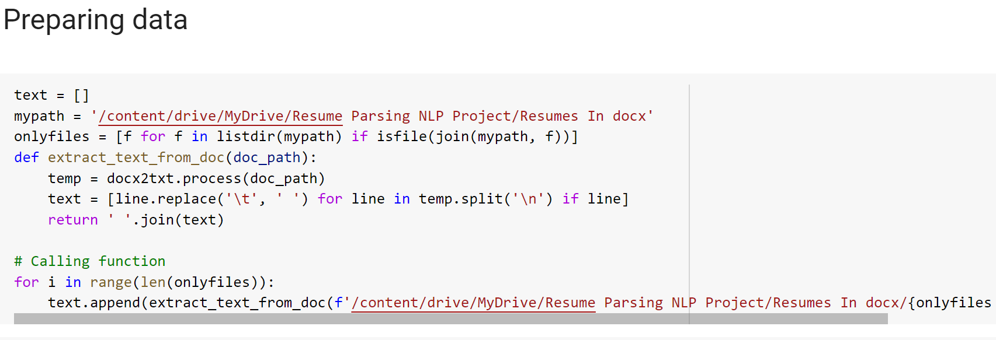

Slide 10
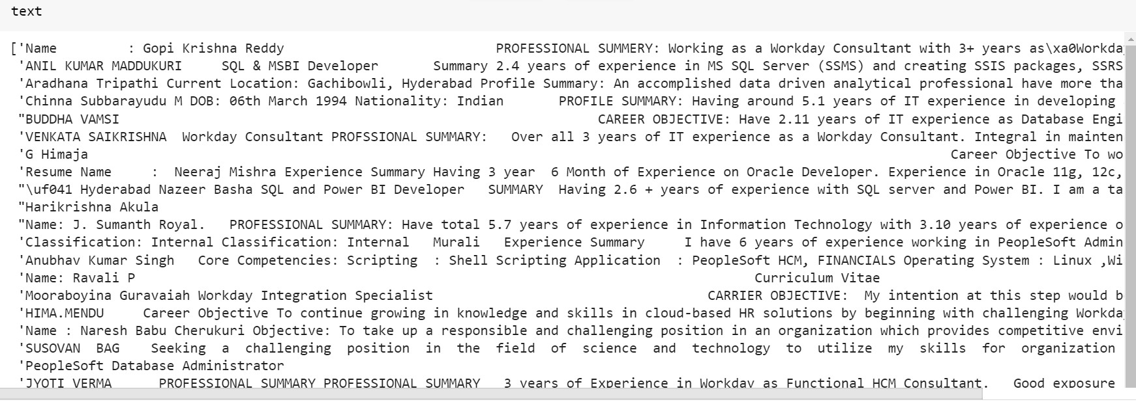
How Dataset Looks

Slide 11
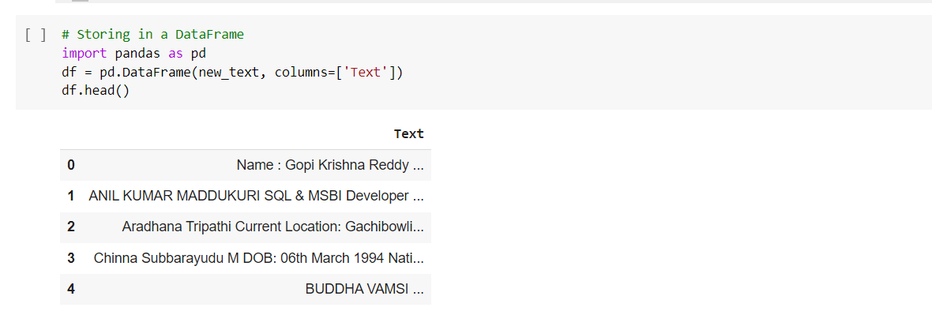
Storing in a DataFrame

Slide 12
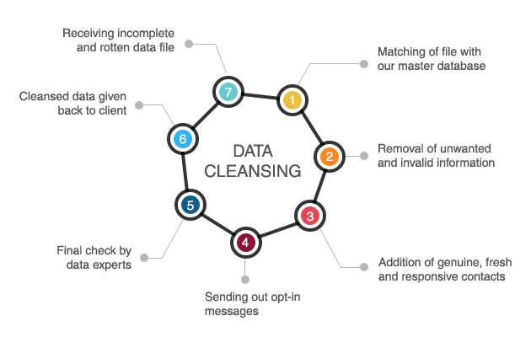
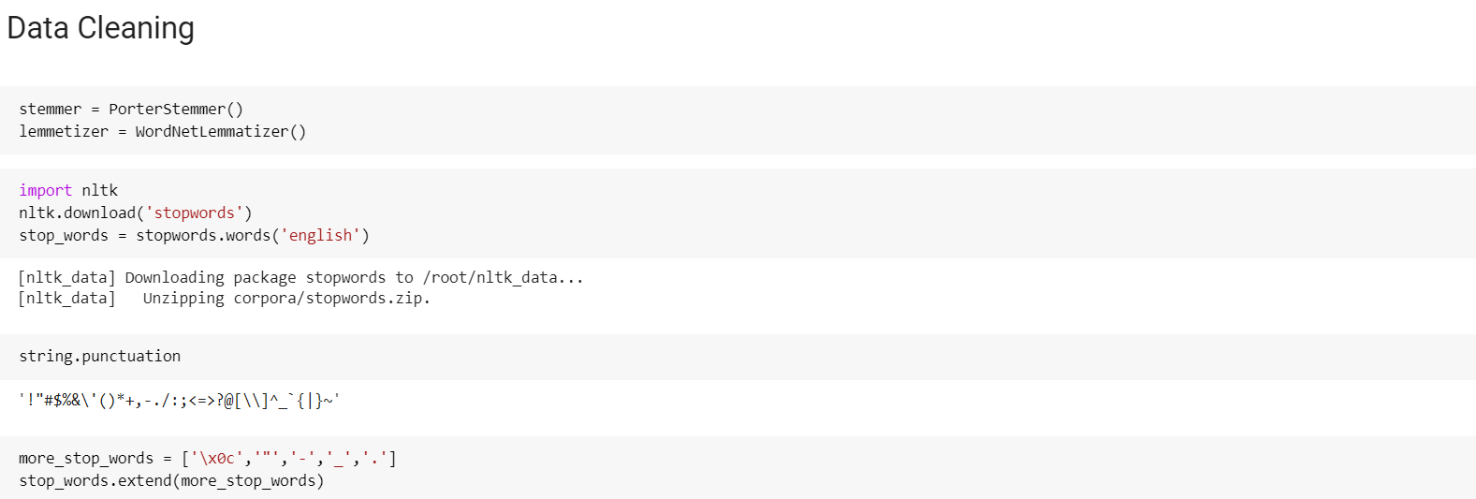
Data Cleaning

Slide 13
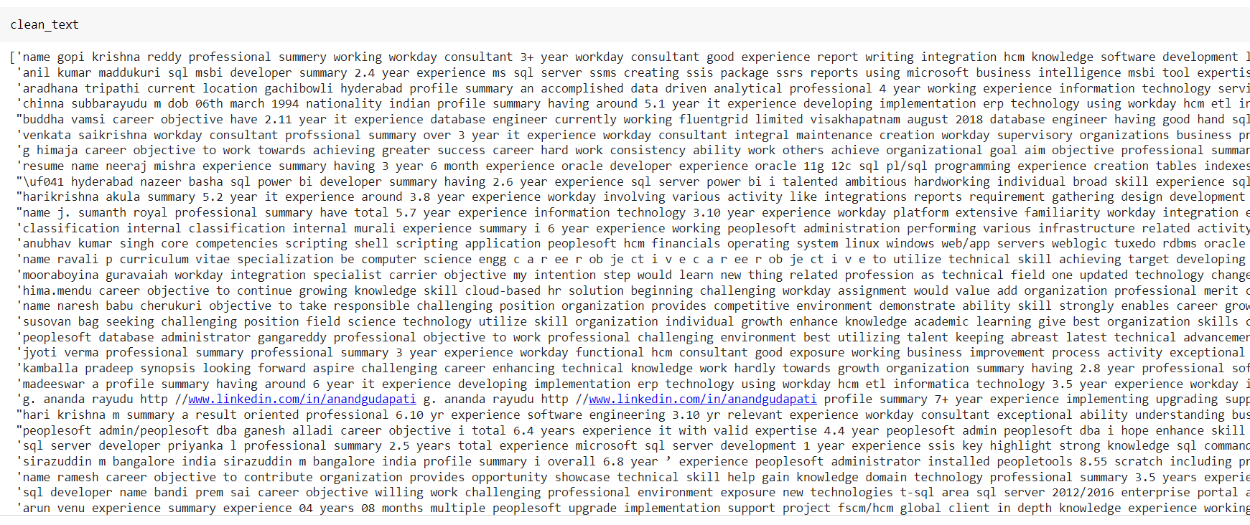

Slide 14
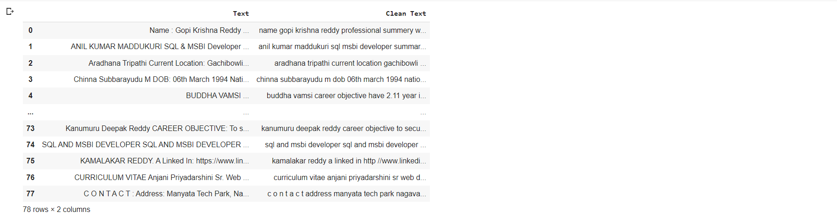

Slide 15
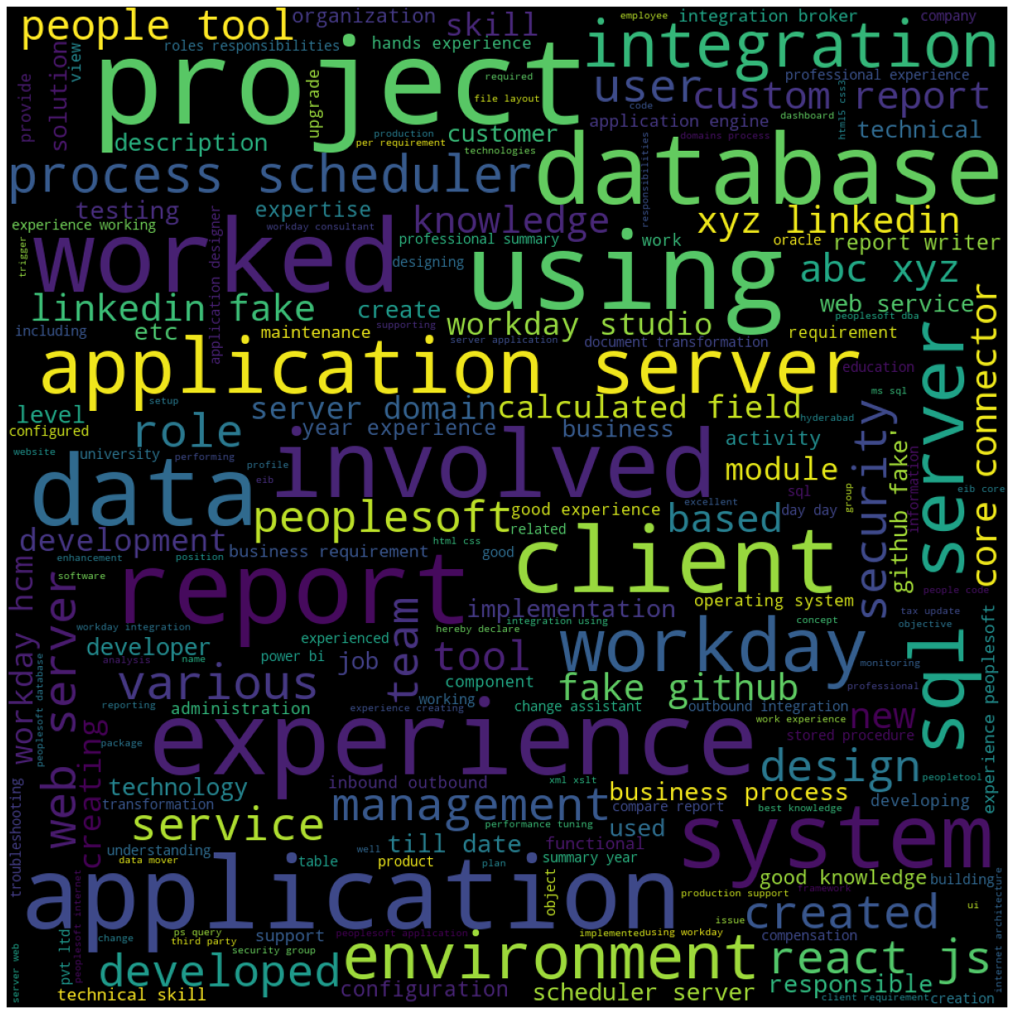
WORD CLOUD

Slide 16
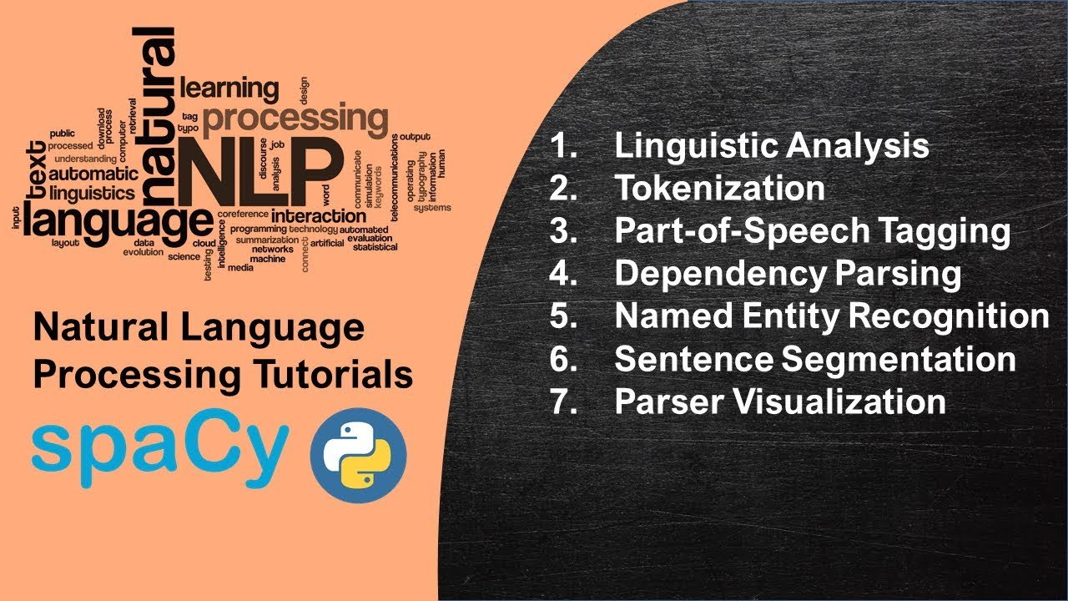
Spacy Features

Slide 17
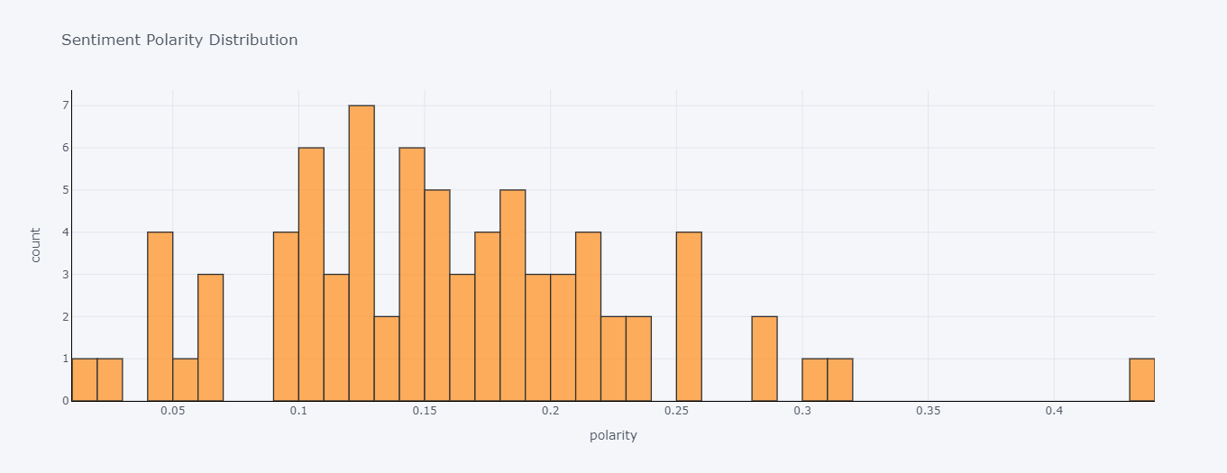
Sentimental Polarity Distribution

Slide 18
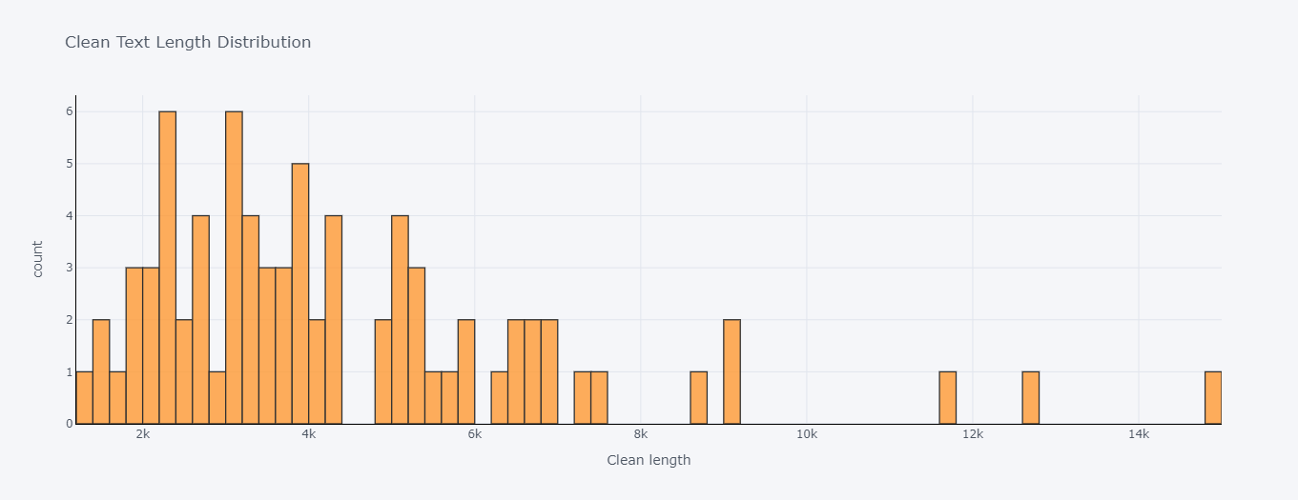
Clean Text Length Distribution

Slide 19
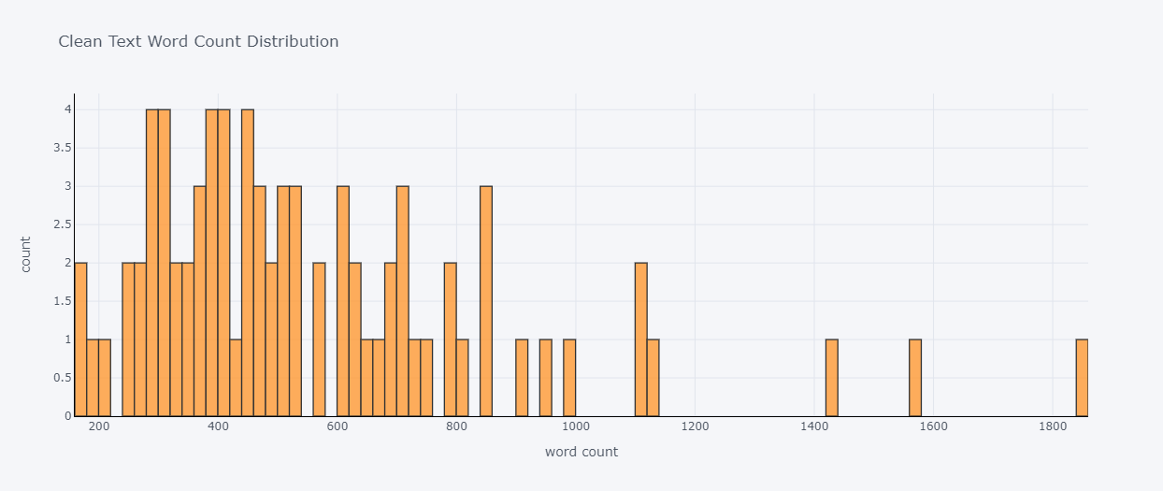
Clean Text Word Count Distribution

Slide 20
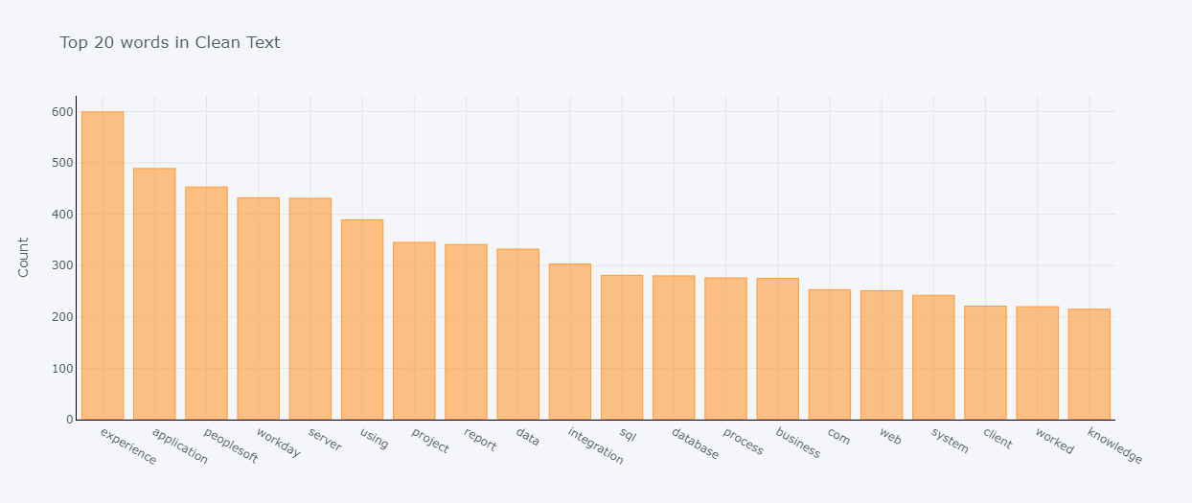
Top 20 UniGrams Words

Slide 21
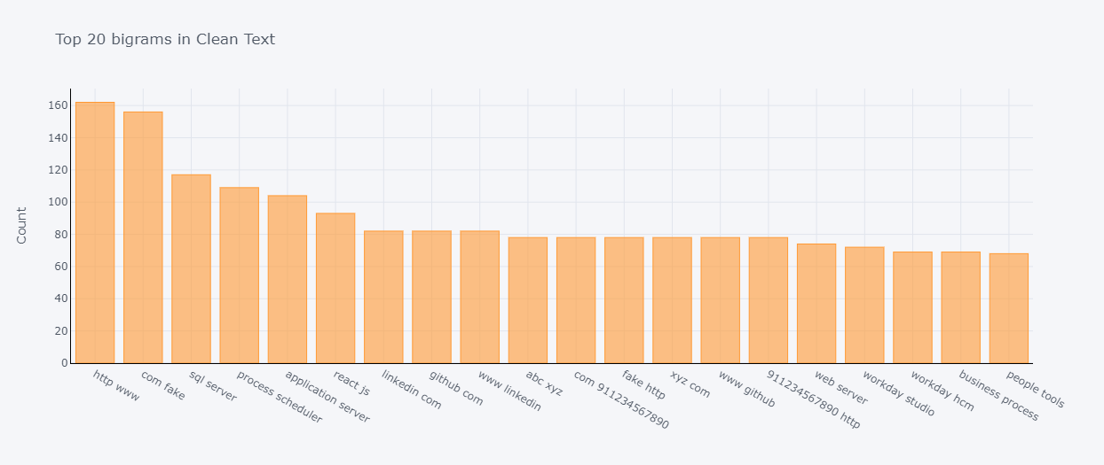
Top 20 BiGrams Words

Slide 22
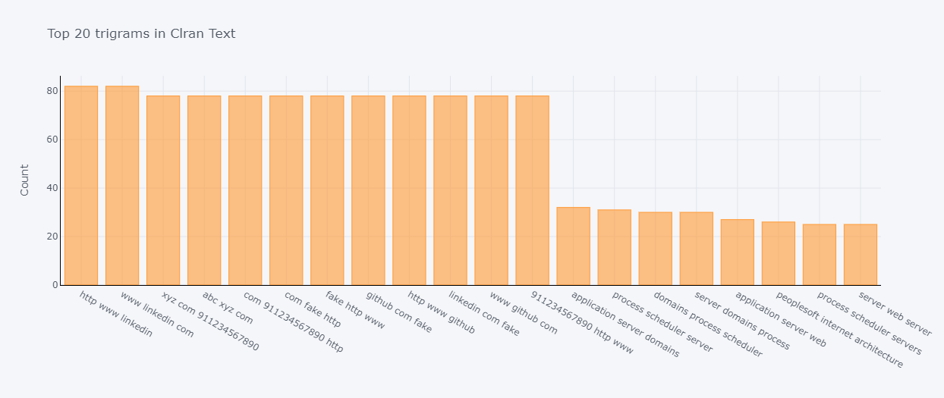
Top 20 TriGrams Words

Slide 23
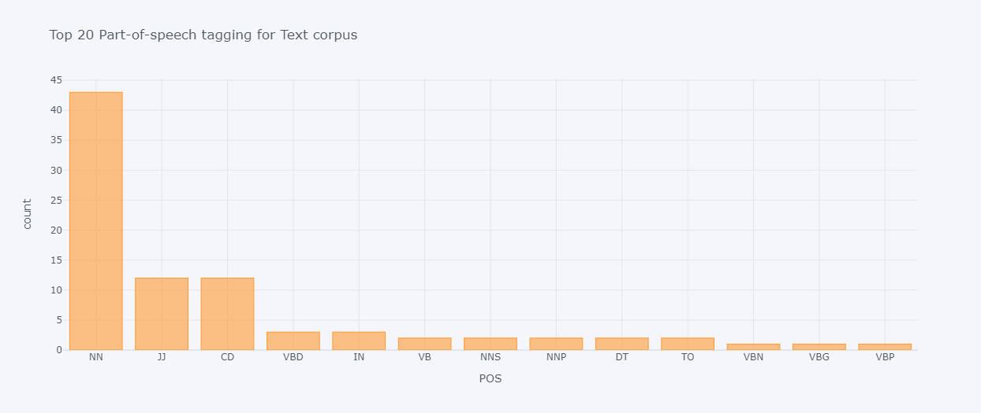
Top 20 Part-of-Speech for Text Corpus

Slide 24
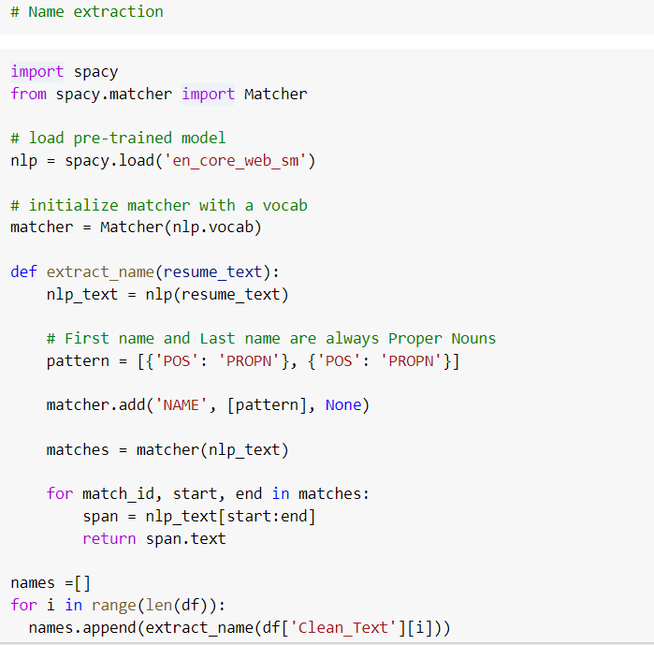
Feature Extraction

Slide 25
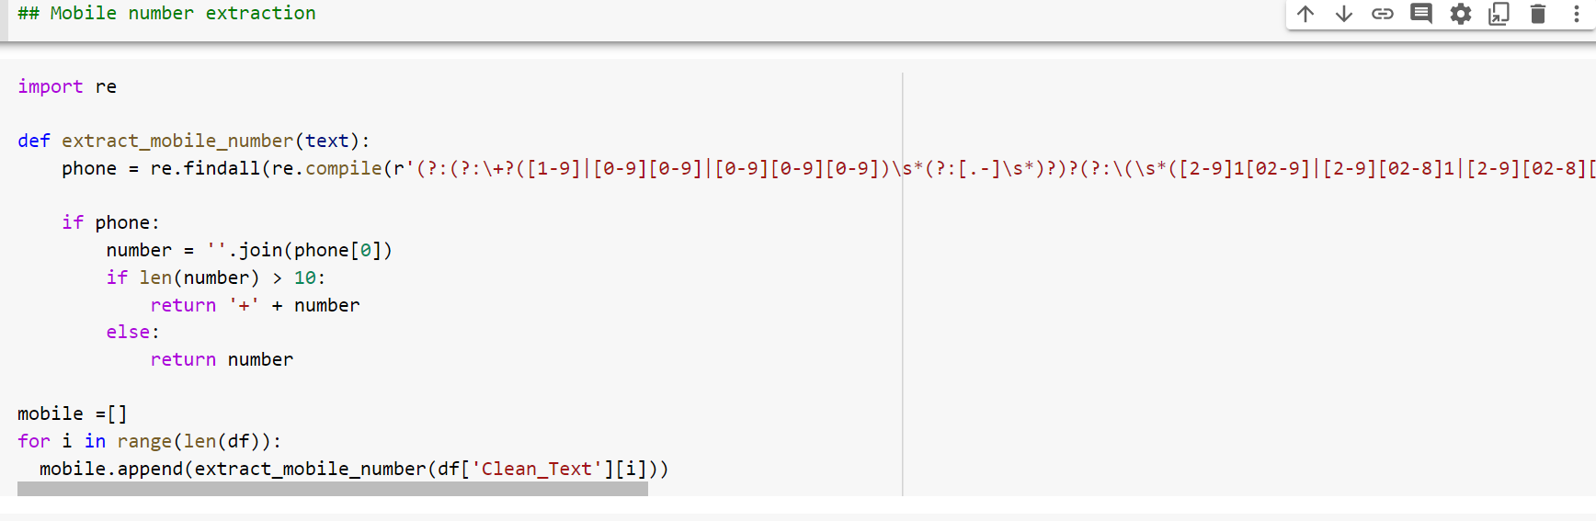

Slide 26
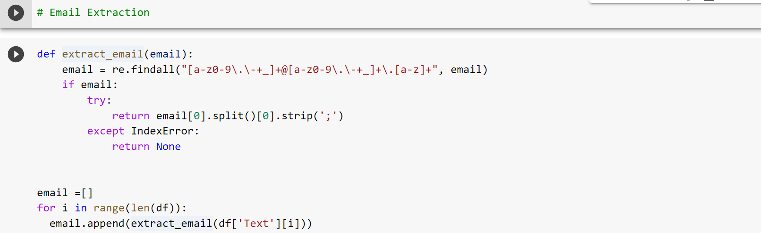

Slide 27
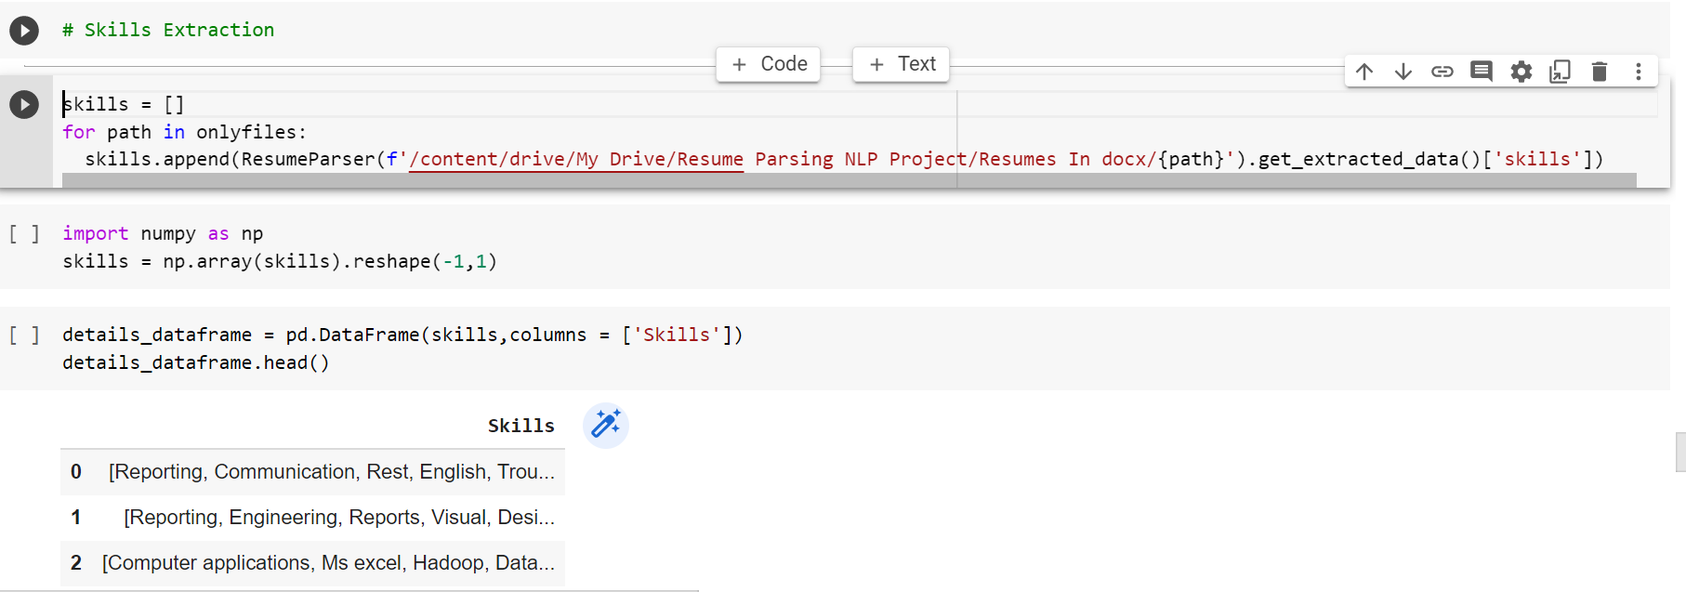

Slide 28
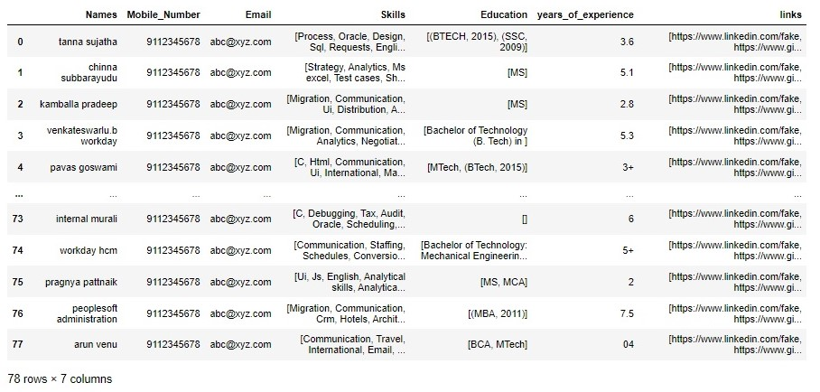
Feature Extraction

Slide 29
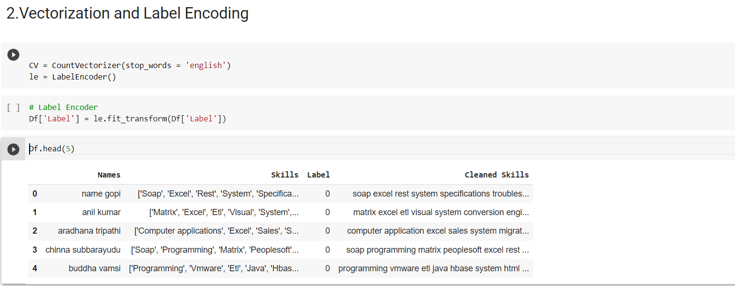
Model Building

Slide 30
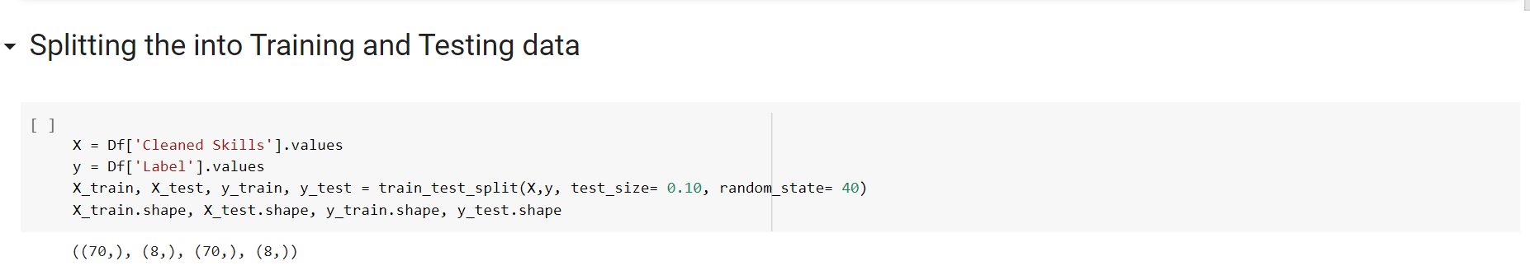
Splitting into Training and Testing Data

Slide 31
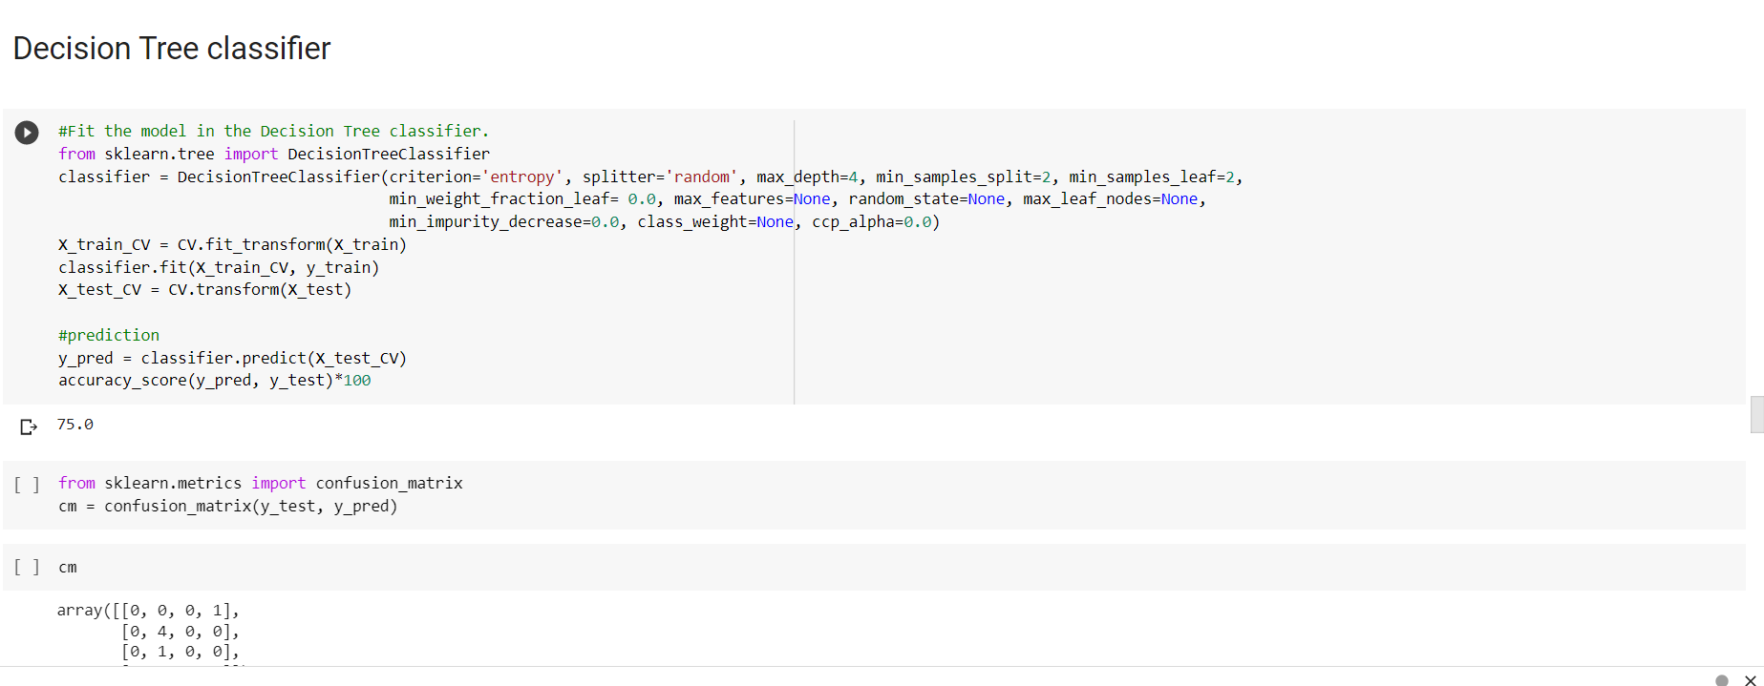

Slide 32
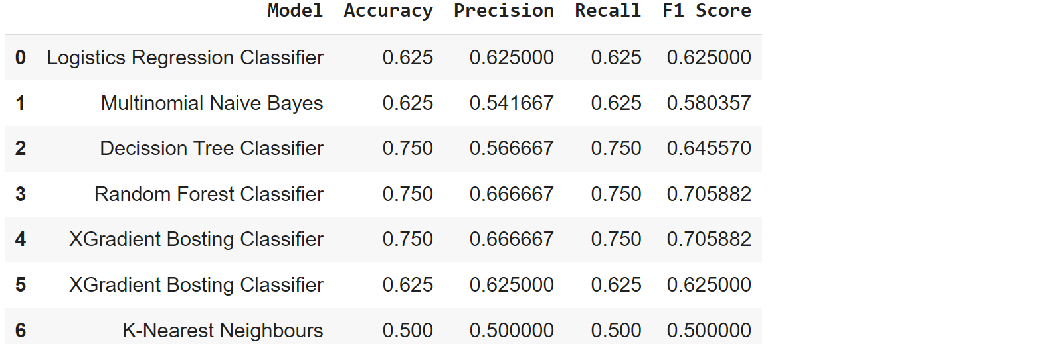
Model Evaluation

Slide 33
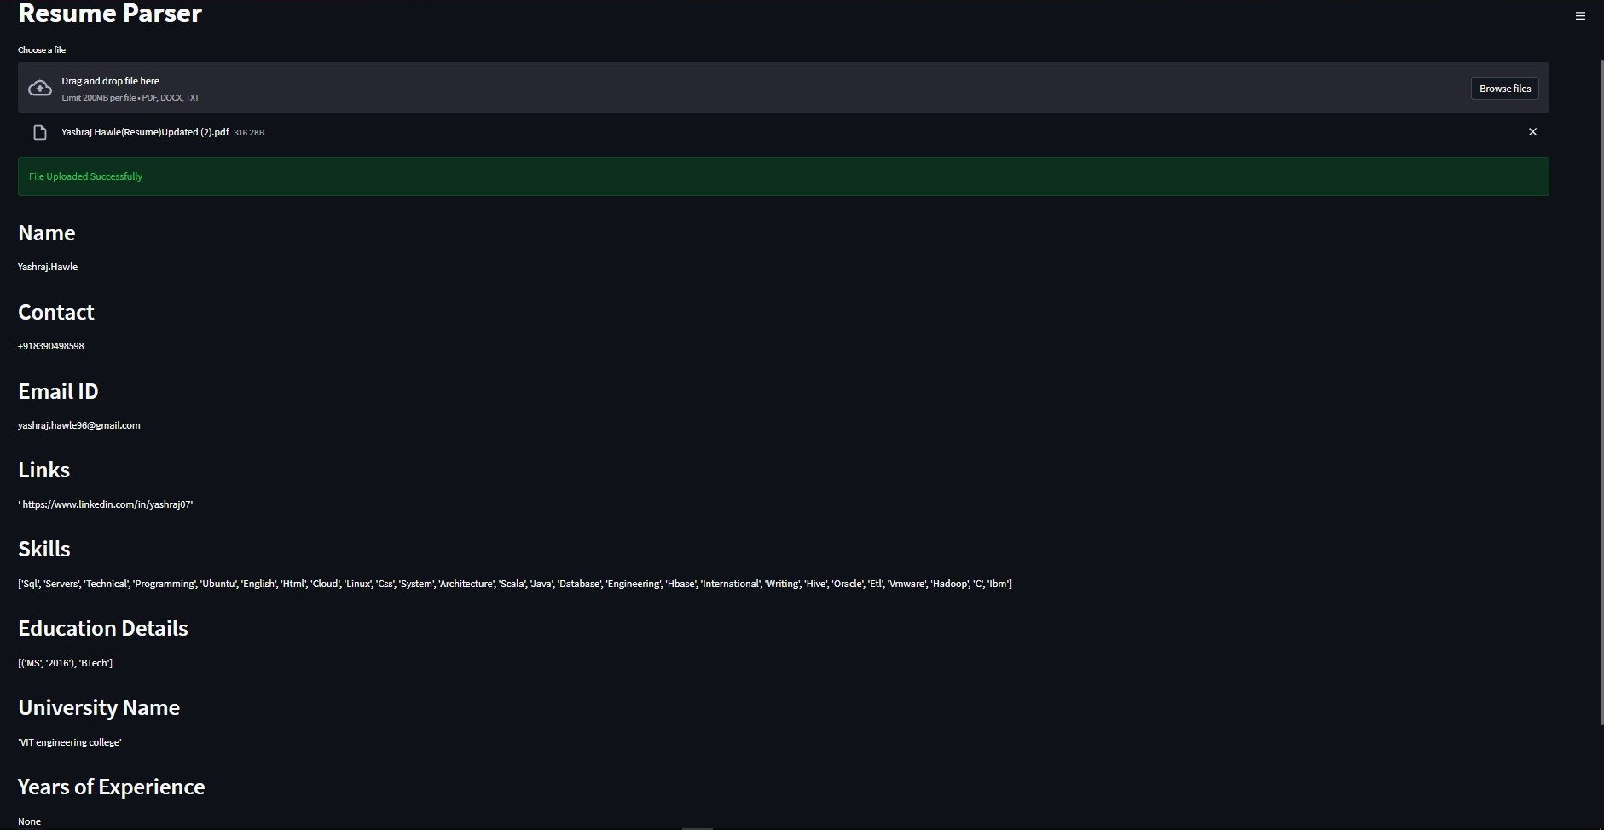
Final Result With Deployment- PDF FILE

Slide 34
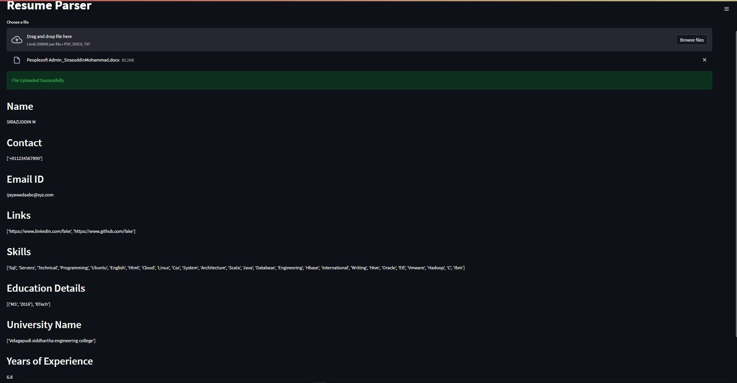
Final Result - Docx FILE

Slide 35
Challenges Faced
Team Co-ordination is a Big issue as some of the team members are working.
Problems faced during Installation of Libraries for NLP on Colab and Jupyter Notebook.
Selecting the model which would work on both Pdf and word format files.
Some members are not aware of deployment how to do that.
How did we Overcome from Challenges
Carried out team meeting on a regular interval to develop a good understanding between the group members.
We shared our task, to tackle different ways to build the model.
Helped and Communicated well in the team and tried to solve other teammate’s problems they were facing.
As most of the Team were not well versed with deployment we split the task and with the help of some of the resources available in the internet we were able to resolve the errors.

Slide 36
Thank you

